Slide 1
GRC AI Agent
Alp Berrak and Carter Jules

Slide 2
Why make an AI Agent?
1
So many regulations
2
Risk Assessments are Time Consuming
Data privacy regulations are constantly being passed or updated, requiring organizations to keep up to date with regulatory requirements which can be tricky when dealing with a global consumer base.
Conducting a thorough risk assessment can be a very time consuming process. An AI Agent is an efficient way to speed up the process by giving a GRC expert a place to start in their assessment.
The scope of this AI Agent is limited to business or finance sector, so the only regulations taken into consideration are those that are spanning or pertain to the business or finance sector.
Notes:
Carter - regulations
Alp - Risk Assessments + Scope

Slide 3
Background Information
Data privacy regulations
Data privacy vary from country to country and from state to state
Companies are responsible for keeping up with regulations being passed and face heavy fines if they fail to comply
NIST
NIST develops widely used cybersecurity guidelines that organizations use to manage risks
We used NIST 800-53 for recommendations in this AI Agent
n8n
To create our AI Agent, we used n8n - a workflow automation tool used to automate tasks visually
Has the ability to integrate with Slack, which allows us to create an agent that doesn’t have to be called from the n8n platform making it more usable
Has ability to pull supplemental information from outside sources like GitHub to tailor AI Agent functionality
Notes:
Carter - data privacy regulations and n8n
Alp - NIST

Slide 4
Objectives
Goals for the AI Agent
User can easily determine what recommendations an organization must follow based on where it operates and where the consumer base is located
User can easily be given possible system upgrades to better meet NIST standards and prevent possible risks
The AI Agent can be easily accessed through a secondary platform and is user friendly
The AI Agent provides output that is readable, concise and accurate
How we achieved this
Using n8n, we created an AI Agent workflow
Integrating Slack enables users to use the AI Agent in an accessible manner
By creating a database in GitHub, we were able to give supplemental information to the AI Agents to provide accurate feedback in a clear manner
By using the Open AI API and the AI Agent nodes, we automated part of the risk assessment process
Notes:
Alp - both goals and how we achieved this

Slide 5
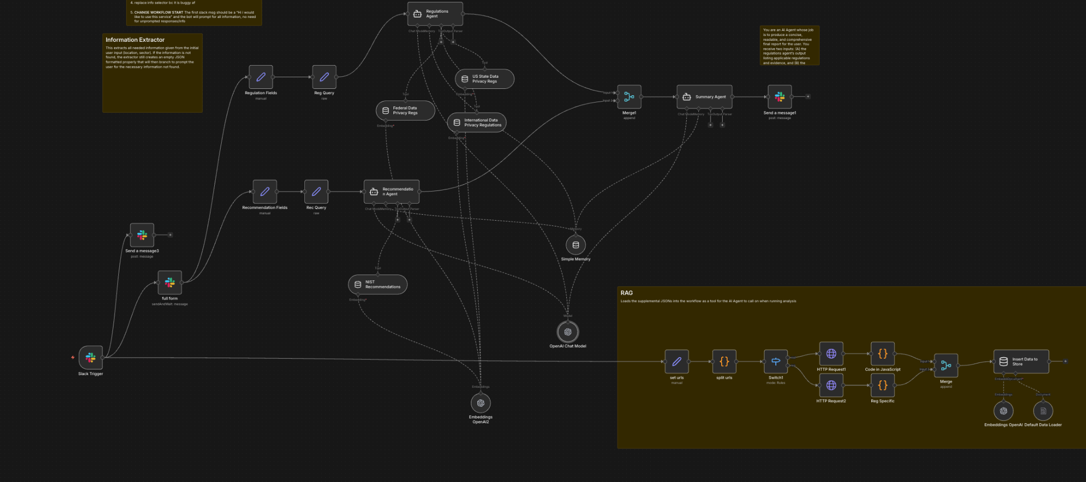
Implementation of the Workflow
Notes:
Carter - whole slide

Slide 6
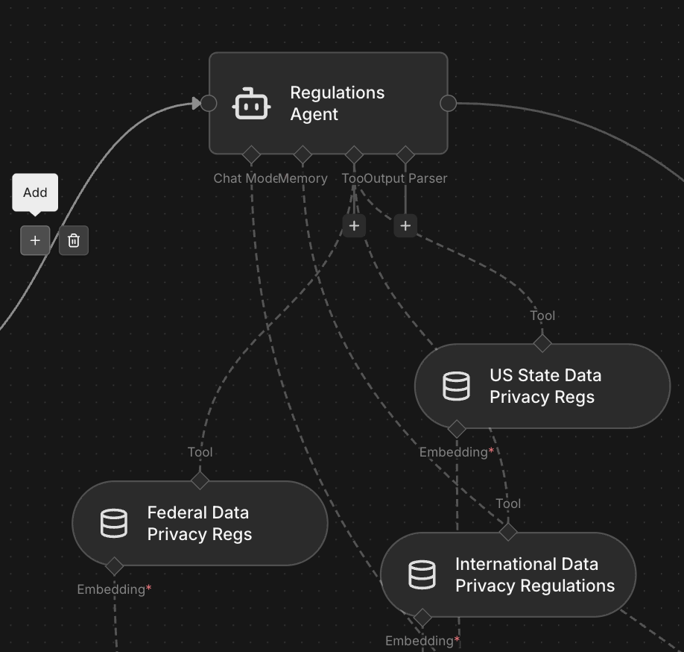
The AI Agent Node
How it Works:
Each AI Agent node has its own system prompt that tailors its functionality
Tools can be created to be called by the AI Agent when needed (e.g. vector stores)
We used the OpenAI model
Agents Used
Regulation Agent: used to determine what regulations the organization must follow
Recommendation Agent: Provides recommended changes to a system configuration based on user input
Summary Agent: creates readable output to send to the user
Notes:
Carter - whole slide

Slide 7
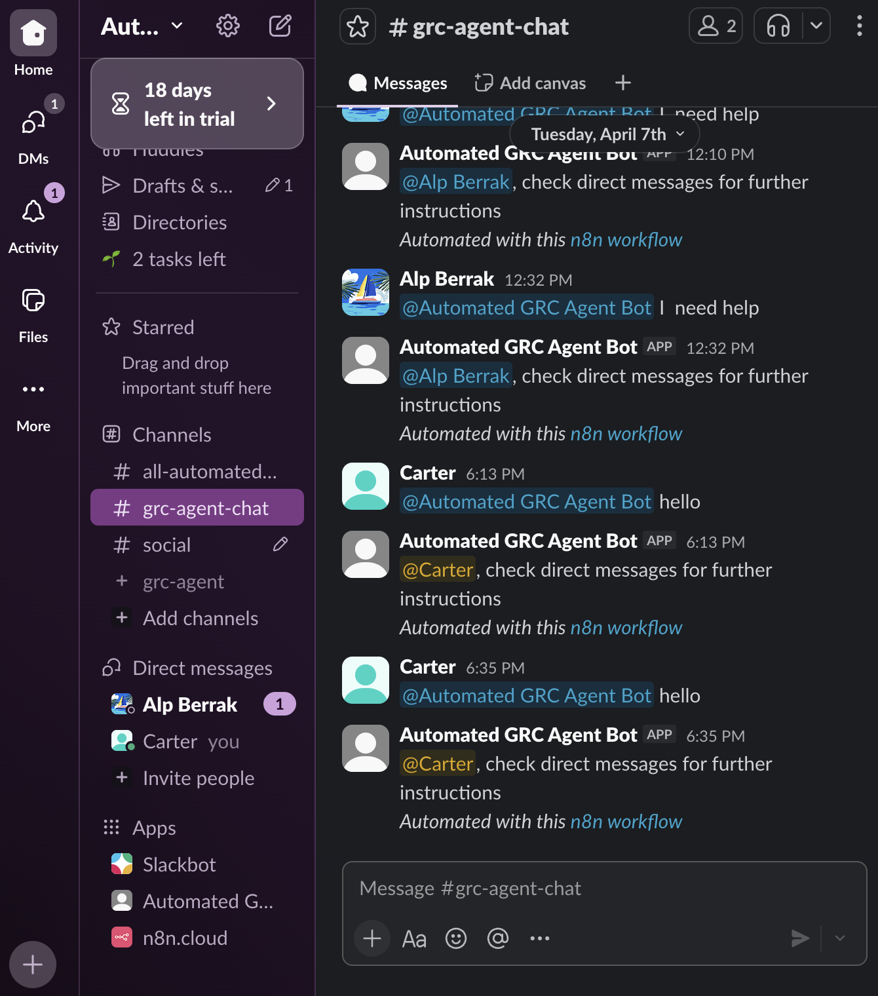
Slack Channel
We are using Slack to send a receive input and output from the workflow
Slack was chosen because it was the most cost effective while still allowing users without n8n accounts to access the AI Agent
We created a bot that can be called to begin executing the workflow and running analysis on a user’s input
Self Evaluation Form
We are using the form feature on slack to get the user input
The form includes the following:
Location
Sector
States (if in US)
Number of users
Self evaluation of the current system configuration - rating and explanation for several aspects of a system configuration
Notes:
Alp - whole slide

Slide 8
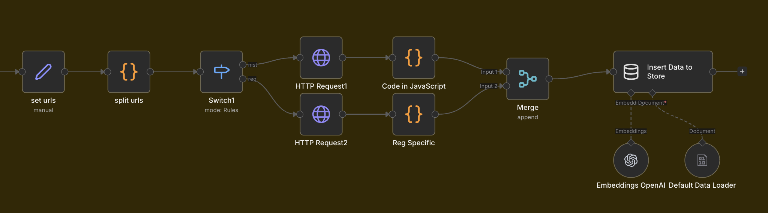
Vector Stores
Vector Stores:
Built out our GitHub repository with different directories containing information about data privacy regulations and NIST recommendations
Formatted as JSONs for easy parsing by the AI Agent and to make appending new information easy
Called to the vector stores in workflow using HTTP Requests
AI Agents then call these vector stores as tools to get information need to create an output
Notes:
Alp - whole slide

Slide 9
Setbacks
n8n Learning Curve
Took some time understanding how the nodes functioned
Had to shift plans a few times because of the functionality in n8n
Parsing User Input Correctly
Had difficulty originally correctly parsing AI Agent because tools we were using often inferred things
Had to rework how users input info for accuracy
Getting User Input
Originally was testing using the built in chat feature in n8n
Had to develop a new way for users to talk to AI Agent for usability
Getting Correct Output
Originally only had one AI Agent for the whole workflow
Split it up into three in order to make the final output more concise and readable for usability
Notes:
Carter - n8n Learnng Curve and Parsing user input correctly

Slide 10
Self Evaluation Example
Asset and Inventory
4: We maintain an asset inventory but it is partially manual, missing cloud resources and transient containers; ownership is not consistently assigned.
IAM
5: I don’t know
Authentication and Authorization
3: MFA is enforced for interactive users but not for API/service keys; token rotation policies are informal and rarely audited
Network and Perimeter
6: Network segmentation is applied to major tiers; however, some legacy public-facing services and broad security group rules remain.
Endpoint and Host Security
7: EDR agents deployed company-wide and baseline hardening exists, but patching cadence varies across teams and some endpoints lack full coverage.
Application Security
5: I don’t know
Data Protection and Encryption
4: Sensitive data is encrypted at rest in major stores, but some backups and data exports are not encrypted and key rotation practices are immature.
Backups and Recovery
6: Backups are taken regularly and stored offsite, but restore tests are infrequent and RTO/RPO targets are not validated.
Logging, Monitoring, and Detection
3: Centralized logging exists but retention and coverage are incomplete; alerting thresholds produce many false positives and incident detection is slow
Incident Response and Forensics
4: An incident response plan exists but exercises are rare, roles are not fully practiced, and forensic data collection processes are ad hoc
Vulnerability Management and Patch Process
5: I don’t know
Physical and Environmental Controls
8: Data center access controls, CCTV, and environmental monitoring are in place; some branch offices have less rigorous physical controls.
Location: US
Sector: Business
State(s): California
User Base Size: 120,000
Notes:
Carter - whole slide

Slide 11
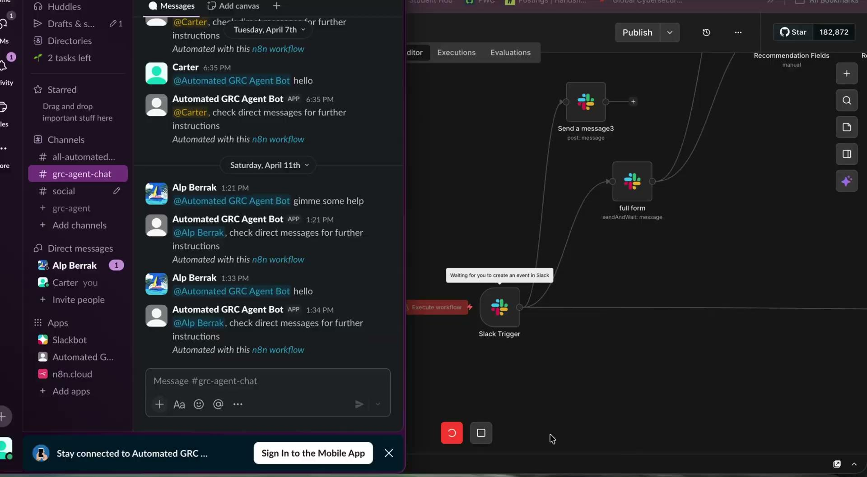
Starting the Workflow
Notes:
Alp - whole slide

Slide 12

Workflow processing
Notes:
Carter - whole slide

Slide 13
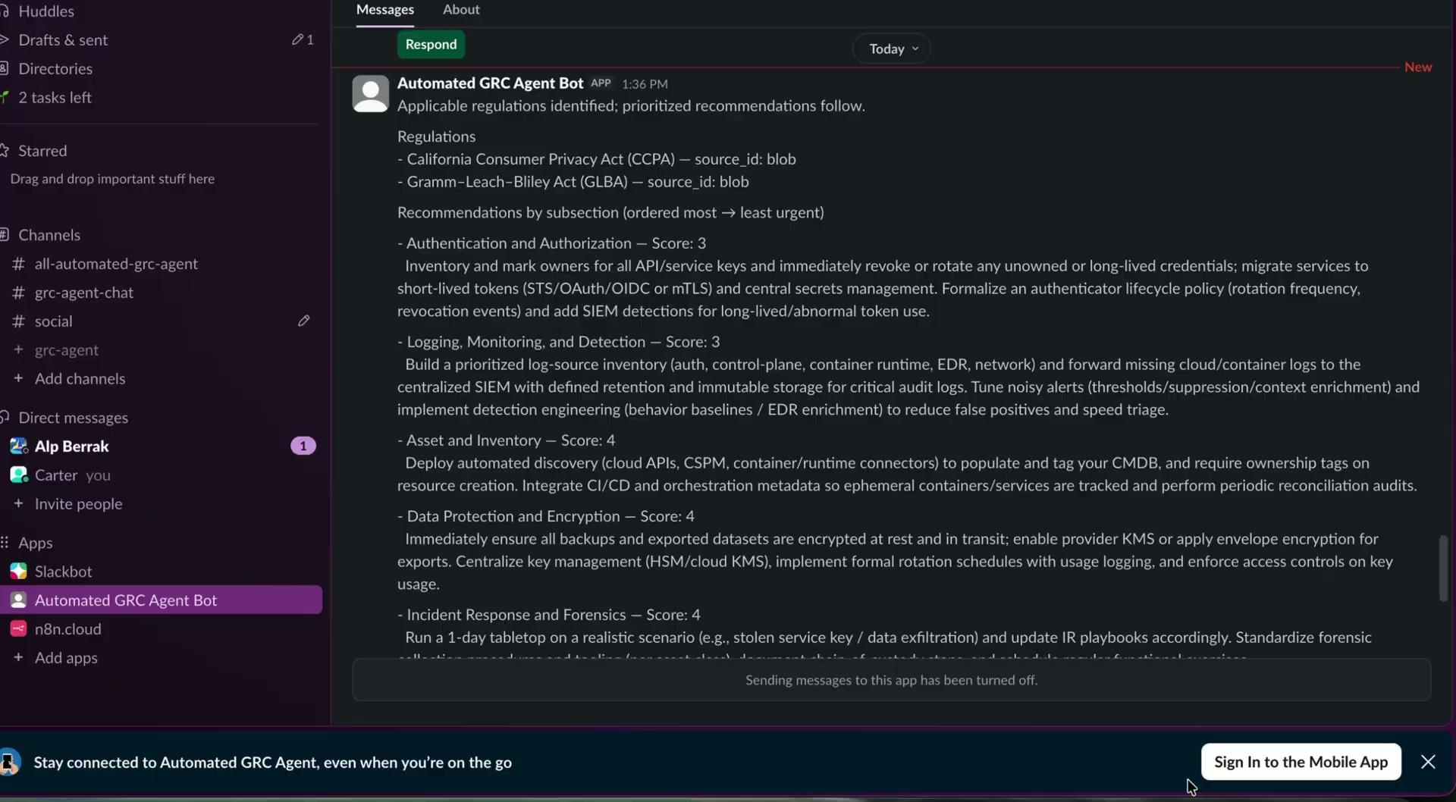
Final Output to User
Notes:
Alp - whole slide

Slide 14
Output Example
Where the user can provide an explanation
- Authentication and Authorization — Score: 3
Inventory and mark owners for all API/service keys and immediately revoke or rotate any unowned or long‑lived credentials; migrate services to short‑lived tokens (STS/OAuth/OIDC or mTLS) and central secrets management. Formalize an authenticator lifecycle policy (rotation frequency, revocation events) and add SIEM detections for long‑lived/abnormal token use.
Where the user says “I don’t know”
- Identity and Access Management — Score: 5
Publish a centralized IAM policy (roles, lifecycle, review cadence) and consolidate interactive access through SSO with role/attribute‑based controls enforcing least privilege. Implement automated provisioning/deprovisioning and quarterly privileged access reviews.
Notes:
Carter - whole slide

Slide 15
Thank you!
Any questions?
Notes:
Both of us answer questions

